Slide 1
Deploy Apps on Render

Slide 2

Render is a cloud platform that simplifies the deployment of web applications, APIs, static websites, and background jobs. It provides a streamlined experience for developers to host their applications without needing to manage complex infrastructure.

Slide 3
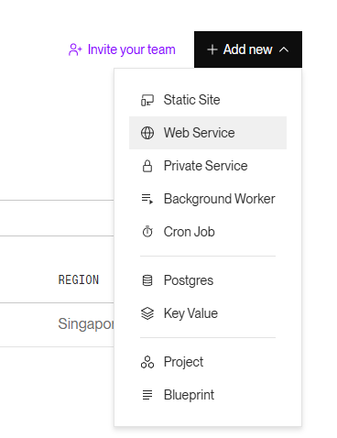

Slide 4
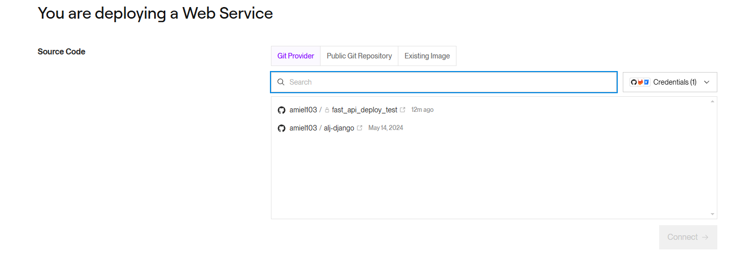

Slide 5
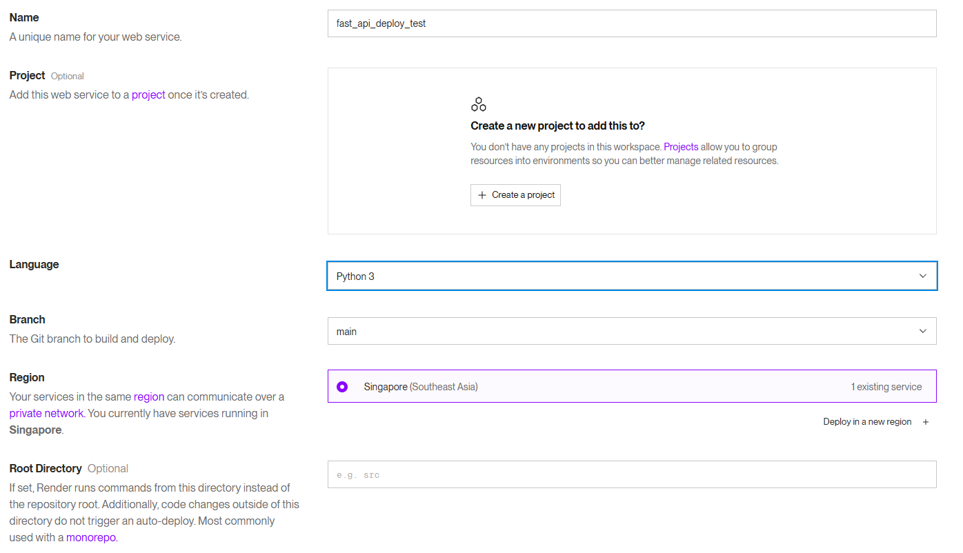

Slide 6
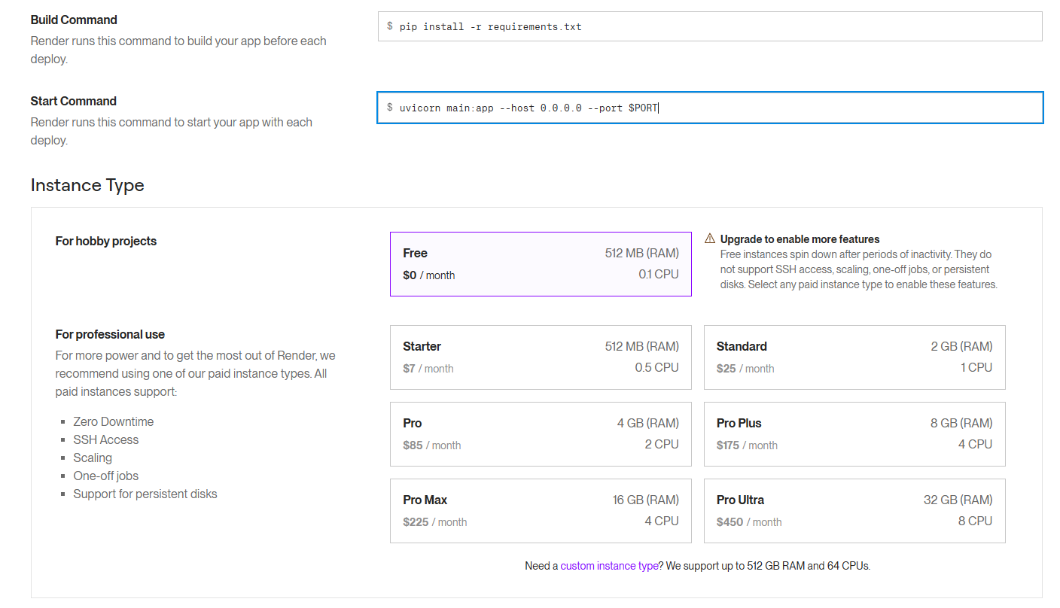

Slide 7
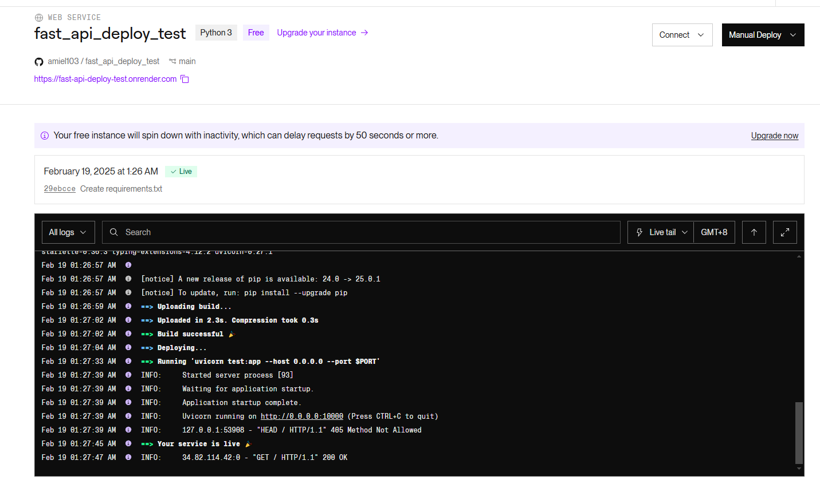

Slide 8
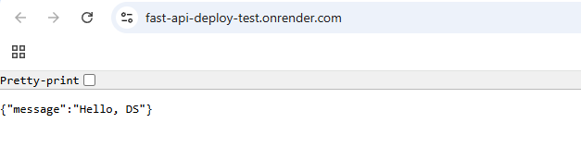
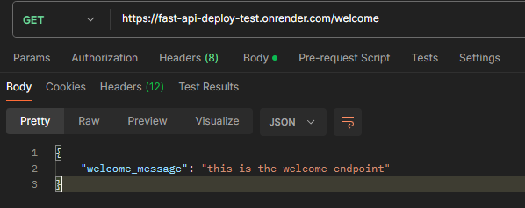

Slide 9
“
Go Go Go
— Rufa Mae Quinto

